Slide 1
HW6 – Permutation Test
Ryan Coslove rmc326

Slide 2
My hypothesis with the p value closest to 0.05
The hypothesis: Low Gross Comedy Movies have higher imdb scores than High Gross Action Movies
The Null Hypothesis - Low Gross Comedy Movies have the same imdb scores than High Gross Action Movies
The Alternative Hypothesis – Low Gross Comedy Movies have lower imdb scores than High Gross Action Movies
We found that our P value = 0.00014989 using z-score

Slide 3
What is permutation?
Permutation is an alternate to z-test.
Permute (scramble data) 1000, 10000 times…and observe what *random* does
Permutation test plot shows the distribution of differences of mean for N (say 10,000) permutation runs
For my hypothesis, I will be using 10,000

Slide 4
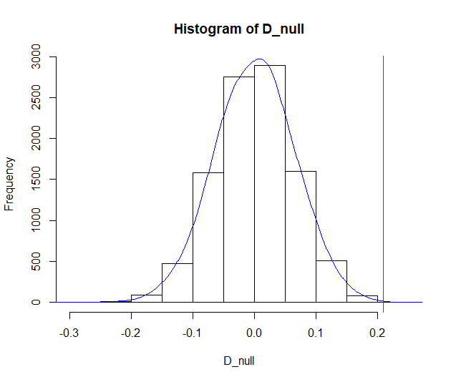
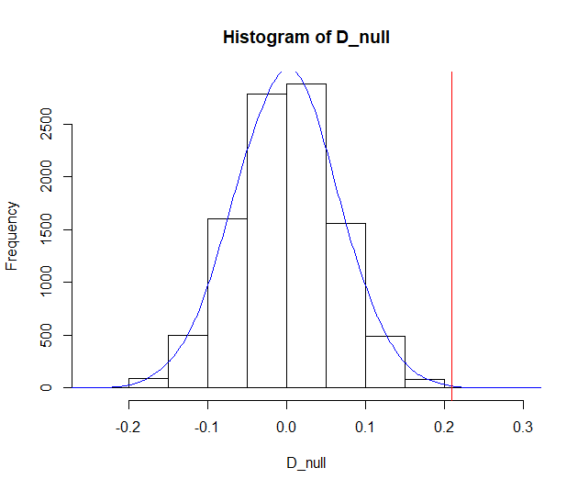
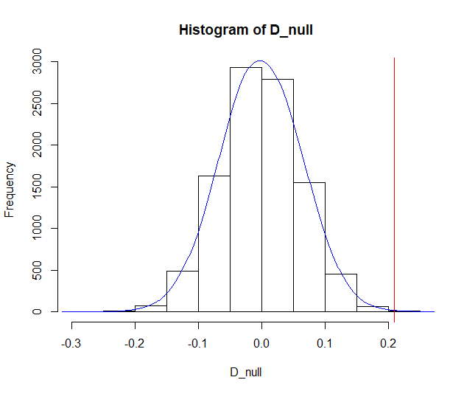
Permutation of my hypothesis:
Using the following function: PermutationTestSecond::Permutation(Com.Act.data,"genre","imdb_score",10000, "Comedy", "Action")
1st Permutation Function Run:
P = 2e-04
2nd Permutation Function Run:
P = 6e-04
3rd Permutation Function Run:
P = 7e-04

Slide 5
Conclusions
After running the permutation test three times, we found p values of 2e-04, 6e-04, and 7e-04 respectively.
We can reject the null hypothesis using each p value
We returned smaller values than the p score we found using z-score in Homework 5
Our results proved statistically significant for the hypothesis of: Low Gross Comedy Movies have higher imdb scores than High Gross Action Movies

